Slide 1
UNIVERSITY OF PENNSYLVANIA
NEURAL + BEHAVIORAL SCIENCES
PHILADELPHIA, PA
REINHARDT SWART
1

Slide 2
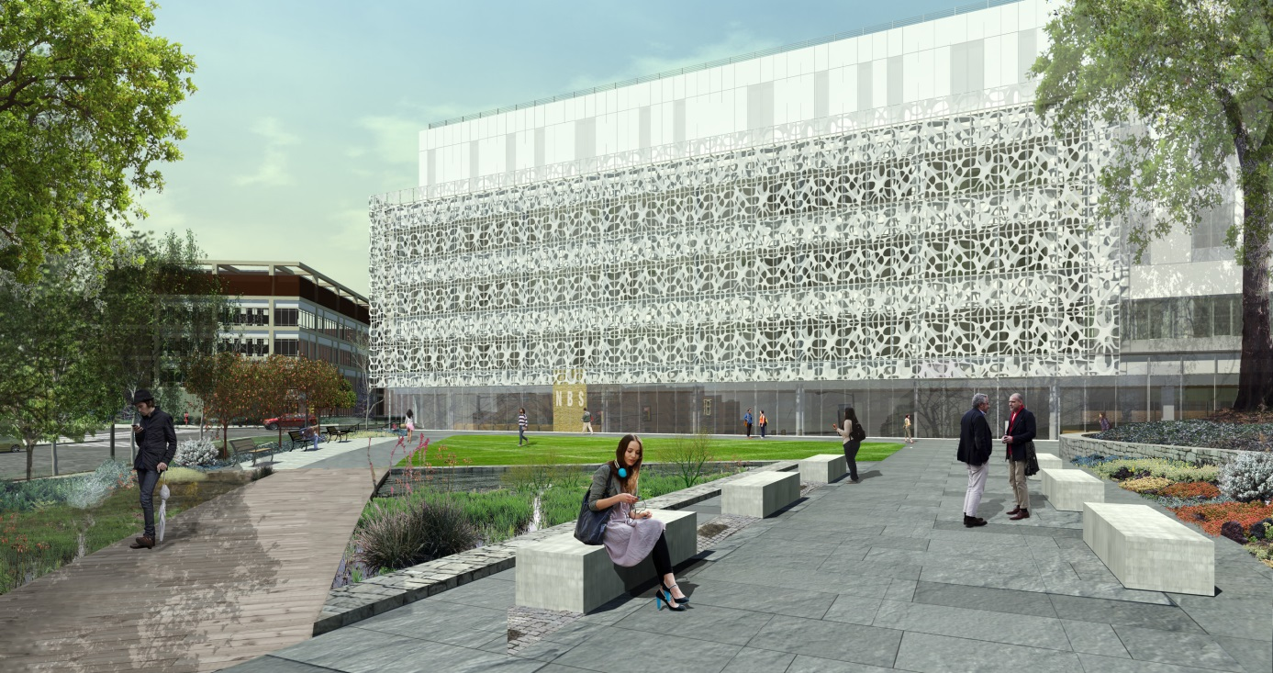
UNIVERSITY OF PENNSYLVANIA
NEURAL + BEHAVIORAL SCIENCES
PHILADELPHIA, PA
REINHARDT SWART
Notes:
Introduction

Slide 3
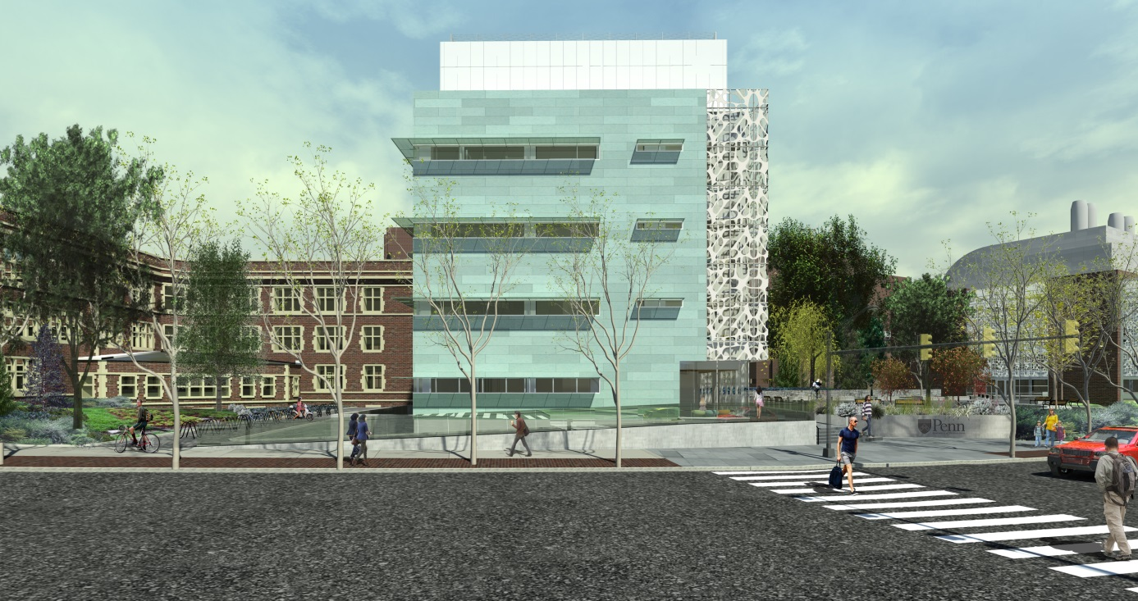
“…the main objective is to have a place where Penn undergraduates who are life science majors have a place where they can relate to…if you bring people together, there’s a higher likelihood of interactions happening among them…”
- Richard Shultz, Associate Dean for the Natural Sciences

Slide 4
“…the main objective is to have a place where Penn undergraduates who are life science majors have a place where they can relate to…if you bring people together, there’s a higher likelihood of interactions happening among them…”
- Richard Shultz, Associate Dean for the Natural Sciences
Notes:
So how are things related to one other…how do they interact…are they connected through nature?
Architect: “Form is based on an accumulation of connections”

Slide 5
overview
name neural and behavioral science building
location philadelphia, pa
size 77,100 gsf
occupancy business, assembly, storage
cost $49,300,000
delivery guaranteed maximum price
architect smithgroupjjr
const. manager p. anges
building | concept | scrim | lobby | classroom | lecture hall | conclusion
Notes:
Neural and Behavioral Sciences major: study and research in the cognitive sciences focus on ways that the brain’s physical qualities, intelligence processes, behavior and communication interconnect.

Slide 6
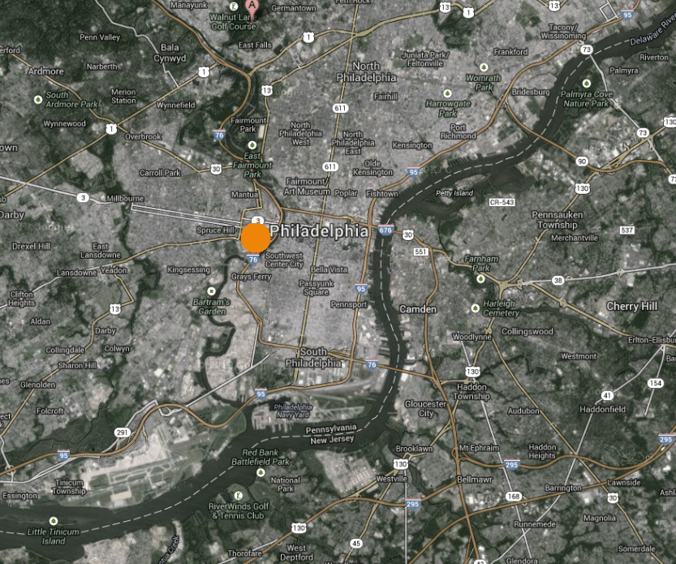
location
N
building | concept | scrim | lobby | classroom | lecture hall | conclusion

Slide 7
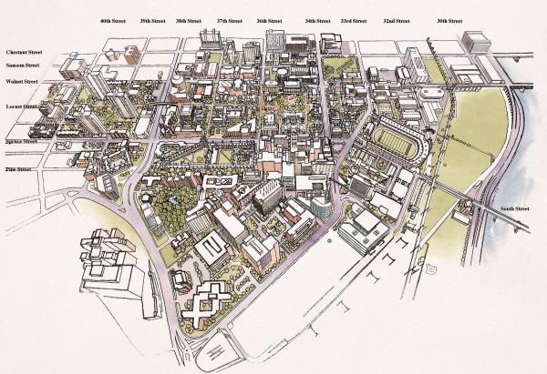
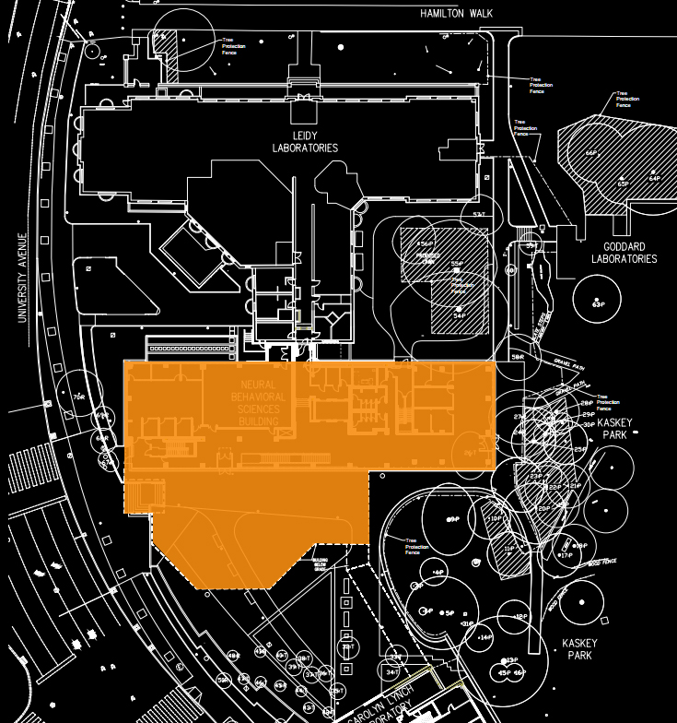
location
N
building | concept | scrim | lobby | classroom | lecture hall | conclusion
Notes:
Southwest corner of campus, connected to the Leidy (north) and Lynch (south) laboratories. Replacing Kaplan wing

Slide 8
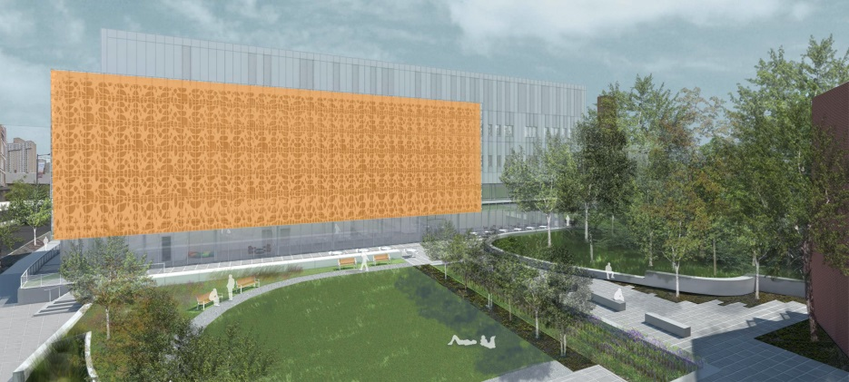
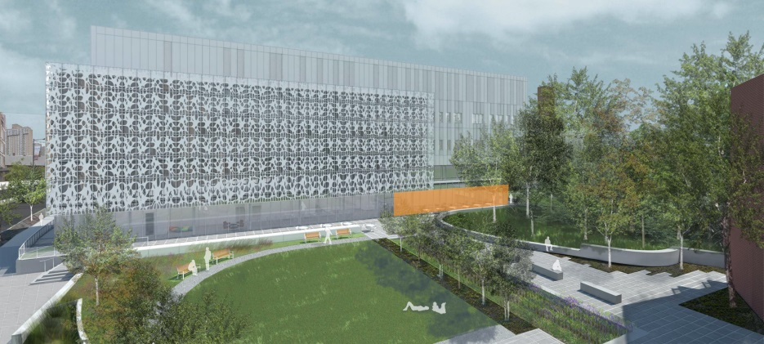
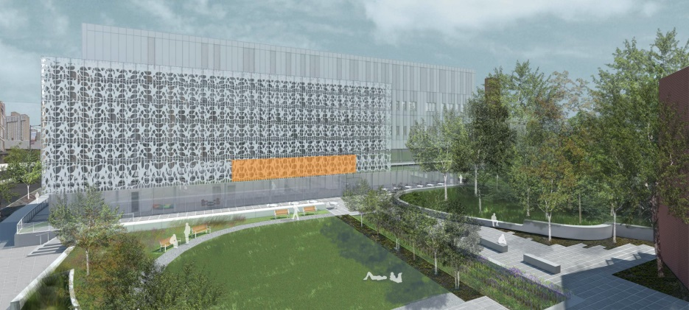
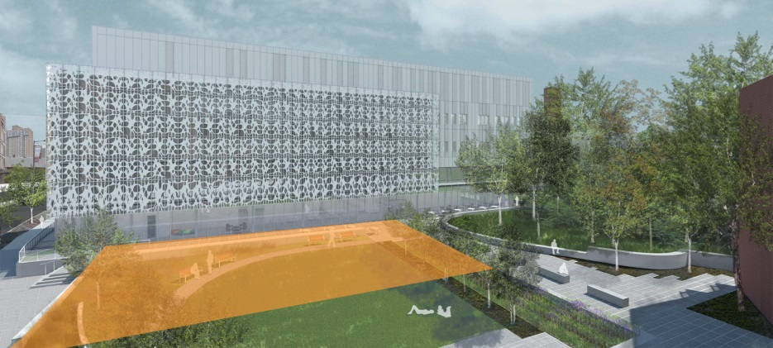
spaces
scrim/facade
lobby
classroom
lecture hall
building | concept | scrim | lobby | classroom | lecture hall | conclusion

Slide 9
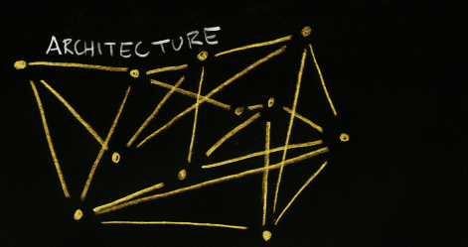
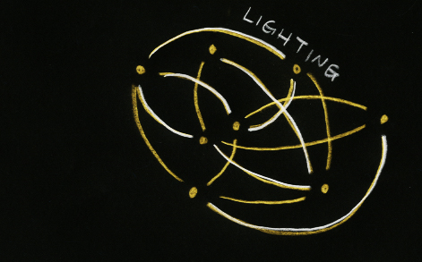
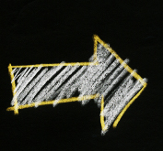
connection + interaction
building | concept | scrim | lobby | classroom | lecture hall | conclusion
Notes:
On the left is one of the architect’s concept ideas – an analytical model. When developing the lighting concept, I wanted to change they way we see connections. I aimed to connect the building through lighting in a holistic and spherical, more cohesive analytical model.

Slide 10
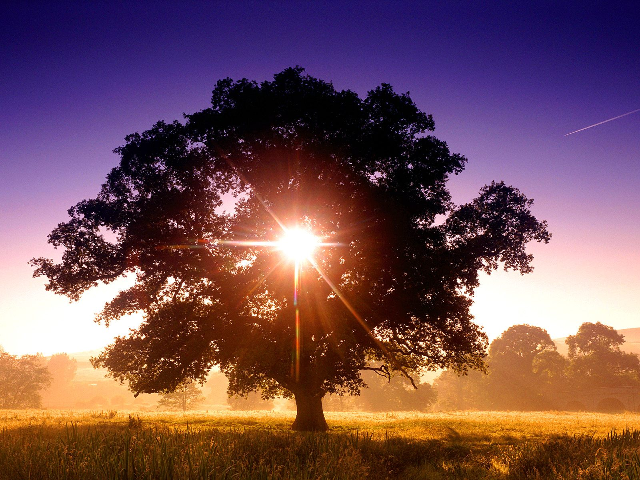
biomimicry
building | concept | scrim | lobby | classroom | lecture hall | conclusion
Notes:
The thought of interconnection between various entities landed me upon a deciduous tree.
The interconnected vascular system of a tree (the roots, stem, leaves) acts much like the human neural system.

Slide 11
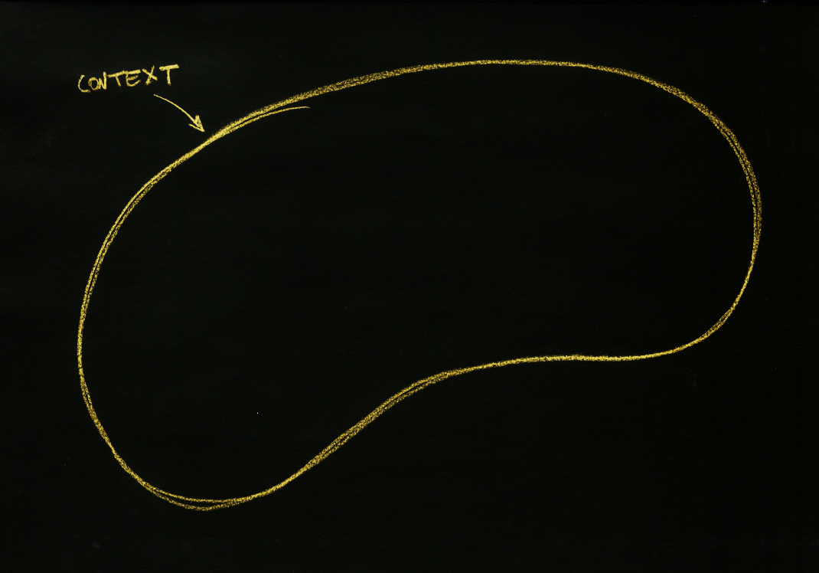
biomimicry
building | concept | scrim | lobby | classroom | lecture hall | conclusion
Notes:
Investigating natural interconnections, I drew to my liking to be inspired by nature. Biomimicry is not a new idea; however, I wanted to develop this idea of biomimicry to drive the lighting solution.
Define: the imitation of the models, systems, and elements of nature for the purpose of solving complex human problems.^{[1]} The terms biomimicry and biomimetics come from the Greek words bios, meaning life, and mimesis, meaning to imitate.

Slide 12
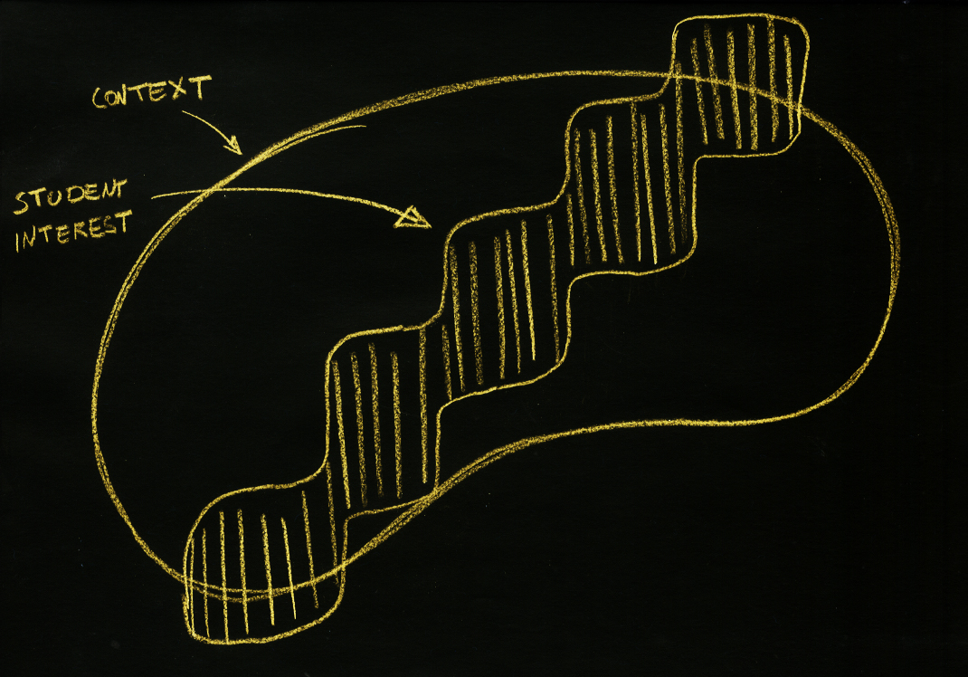
biomimicry
building | concept | scrim | lobby | classroom | lecture hall | conclusion

Slide 13
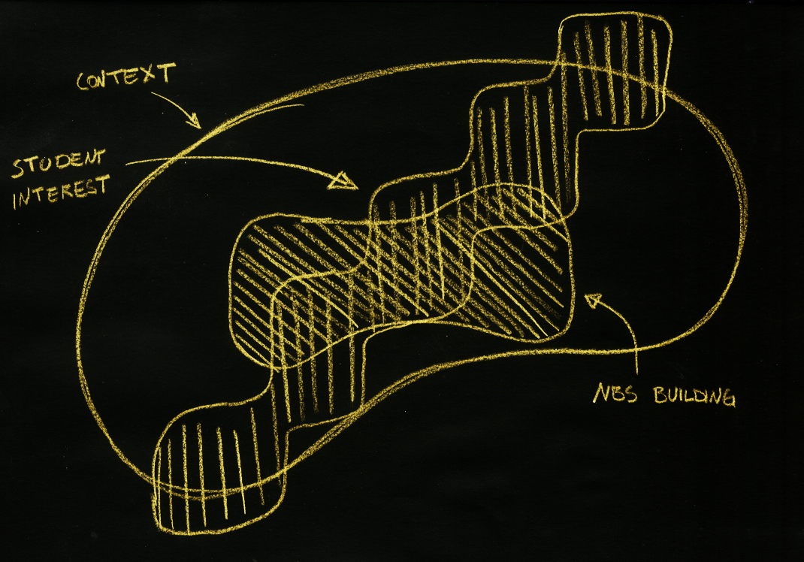
biomimicry
building | concept | scrim | lobby | classroom | lecture hall | conclusion

Slide 14
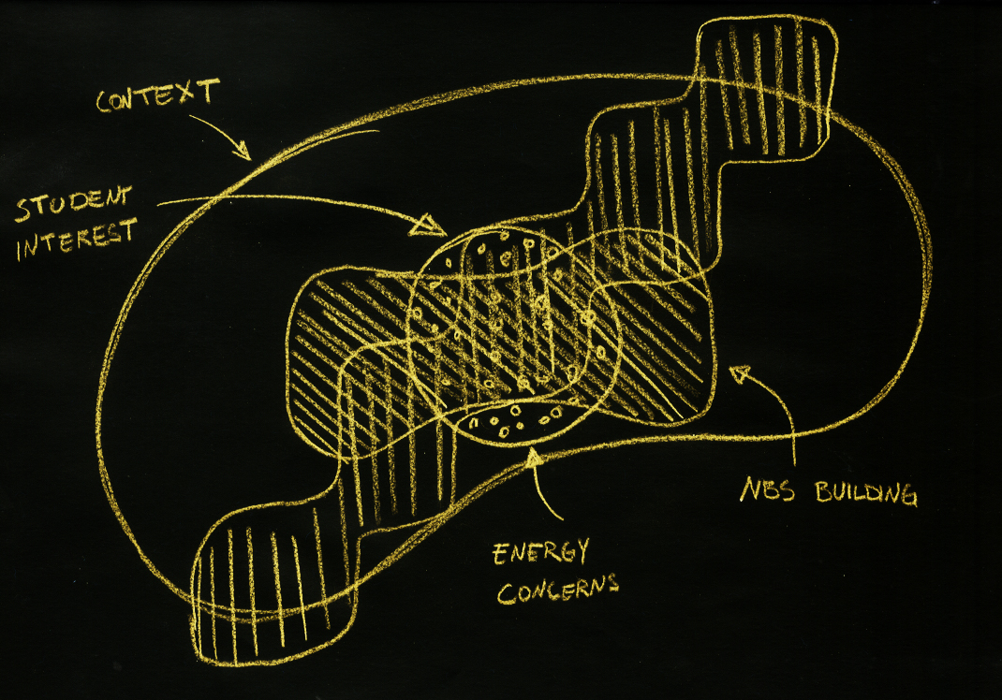
biomimicry
building | concept | scrim | lobby | classroom | lecture hall | conclusion

Slide 15
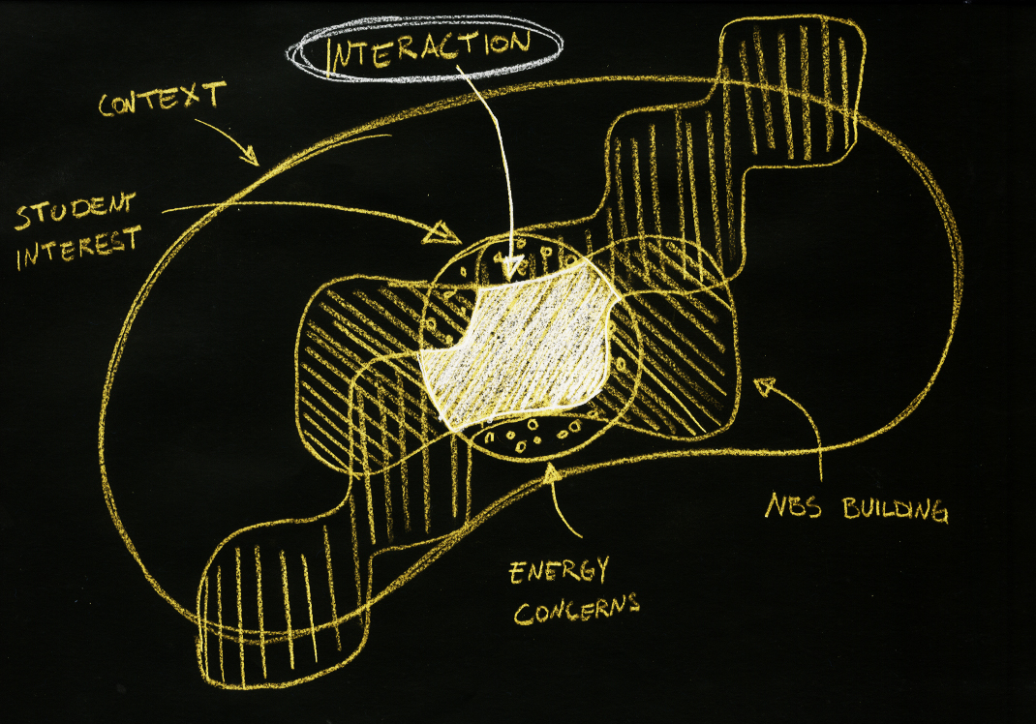
biomimicry
building | concept | scrim | lobby | classroom | lecture hall | conclusion

Slide 16
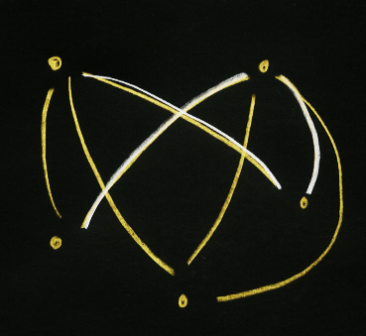
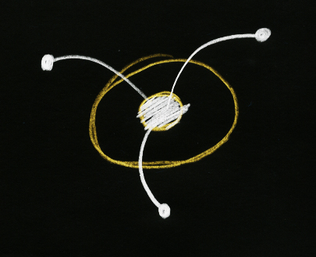
connection + interaction
building | concept | scrim | lobby | classroom | lecture hall | conclusion
Notes:
Simplifying the analytical model further lends to the idea that through lighting, nature, the students, and the NBS building are connected.

Slide 17
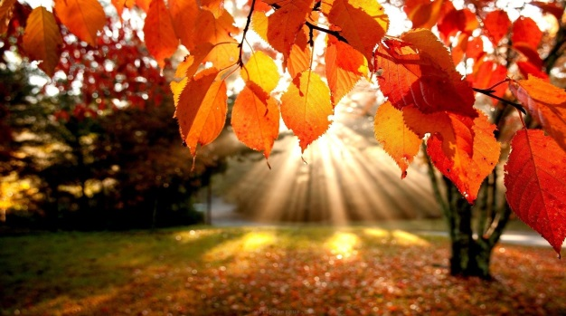
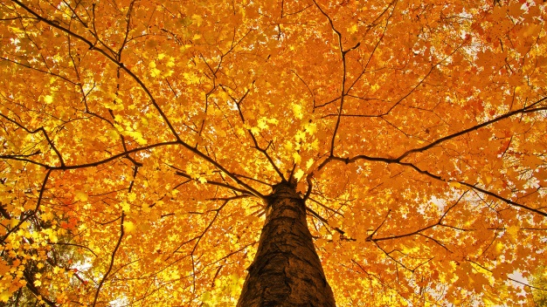
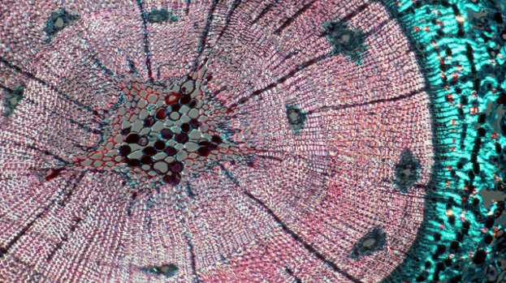
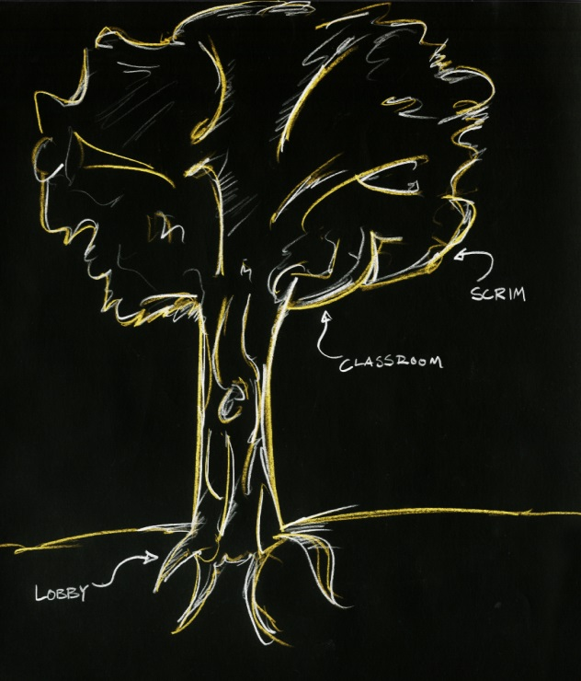
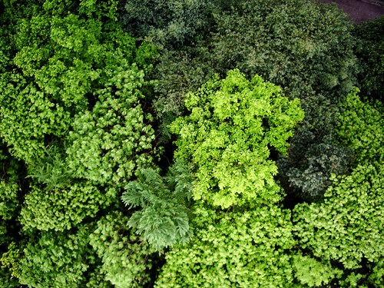
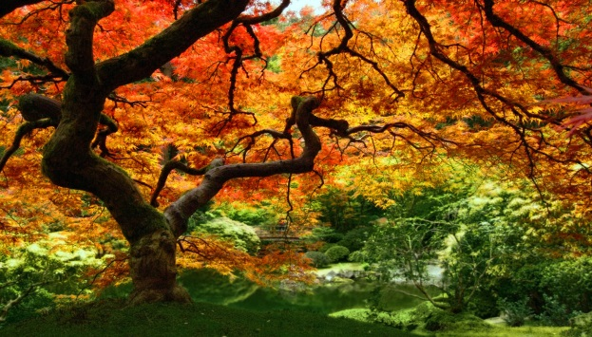
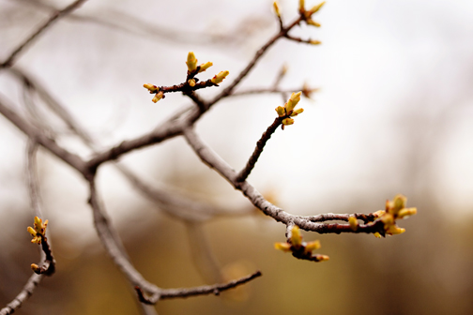
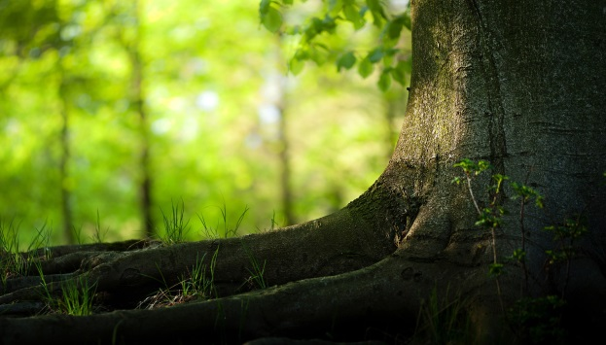
connection + interaction through biomimicry
building | concept | scrim | lobby | classroom | lecture hall | conclusion
Notes:
By mimicking the various functions, forms, aesthetics, emotions, and processes associated with a tree, this connection is established.

Slide 18
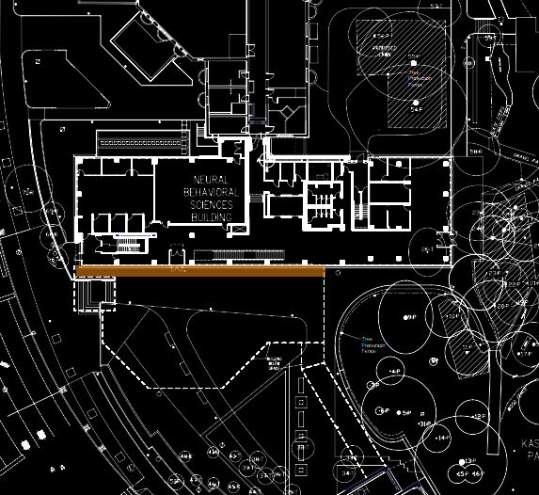
scrim/facade
N
building | concept | scrim | lobby | classroom | lecture hall | conclusion
Notes:
Width: 48 ft
Height: 140 ft
Upenn Standard LED type V direct distribution
*Along corridor*

Slide 19
scrim/facade
building | concept | scrim | lobby | classroom | lecture hall | conclusion
Notes:
The vertical scrim is a single sheet of painted aluminum panel with areas of solid metal, perforated metal with a 40% openness factor (3/8” diameter holes), and voids to create the appearance of multiple layers. The panel units are 3/8” thick. The curtain wall is a butt glazed system with painted aluminum mullions and 1” insulated clear and spandrel glass, adding frit where the scrim does not screen the glazing along the second floor. Metal panels on the southern face of the building are white and gray. Natural low-e 1”clear insulated glazing units span the ground floor corridor and lobby.
Various metal panels and curtain walls next to and behind the scrim.

Slide 20
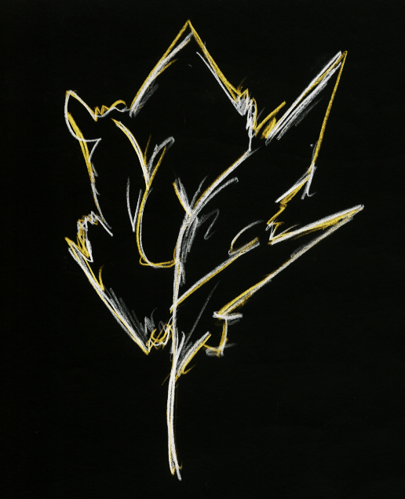
scrim/facade
design criteria
safety + security
accent architecture
minimize obtrusive light
festive flynn impression
building | concept | scrim | lobby | classroom | lecture hall | conclusion
Notes:
4 horizontal lux
10 vertical lux
LZ2 – 8 lumens/SF (44800 lumens)

Slide 21
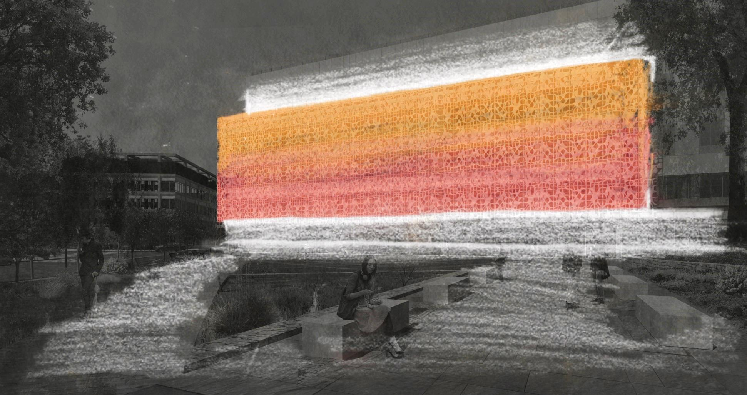
scrim/facade
building | concept | scrim | lobby | classroom | lecture hall | conclusion
Notes:
During the day, the scrim (and building) responds to the sun. Through a process known as photosynthesis, glucose is generated in leaves of deciduous trees which helps the tree grow. However, as fall days get shorter and temperature drops, the production of chlorophyll decreases giving rise to red, orange, and yellow pigments in the leaves. The scrim then, is a festive expression of the absence of light. It is a composition of pastel colors, slowly changing colors throughout the night to make the building recognizable not only during the day but also at night. Students at UPenn will recognize this building; through the response to nature, they will relate
FESTIVE IMPRESSION, slow pastel color changing

Slide 22
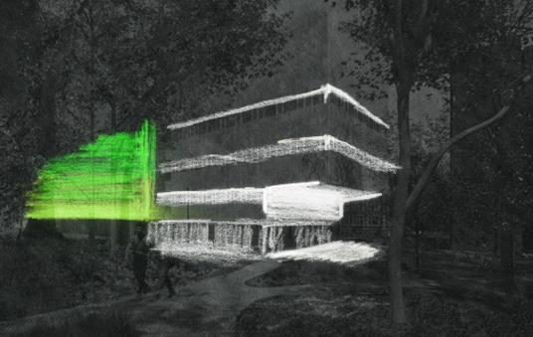
scrim/facade
building | concept | scrim | lobby | classroom | lecture hall | conclusion
Notes:
Color scheme (red, orange, yellow, green, blue)

Slide 23
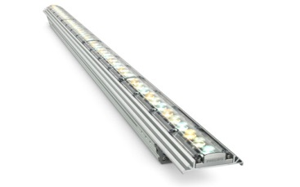
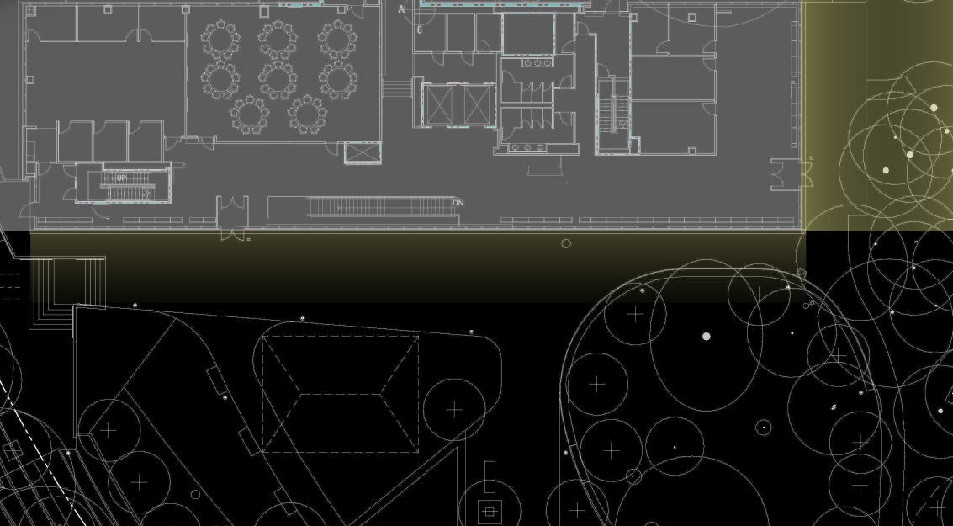
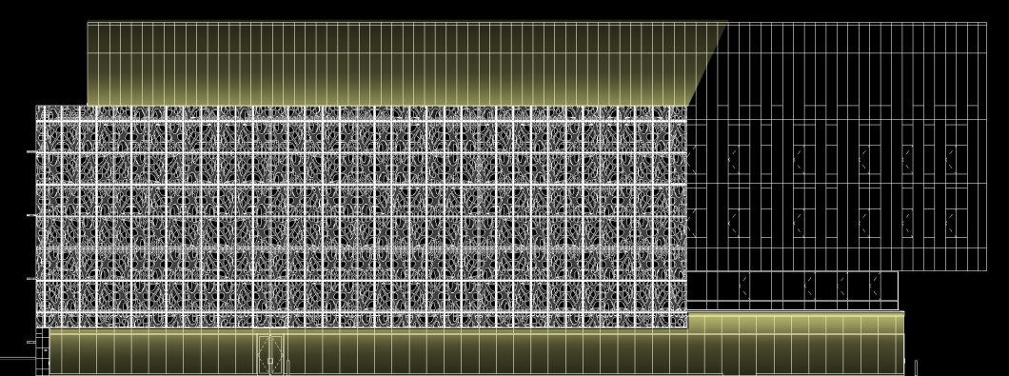
scrim/facade
building | concept | scrim | lobby | classroom | lecture hall | conclusion
Notes:
White flood like to separate scrim from building – as if falling leaf.

Slide 24
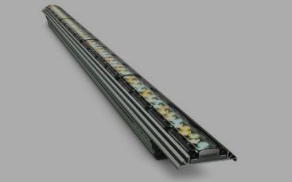
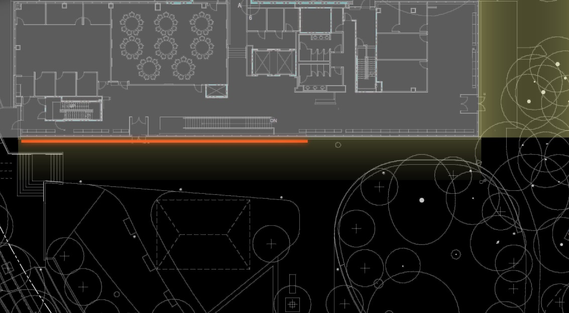
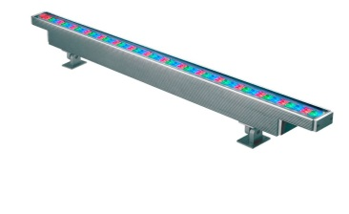
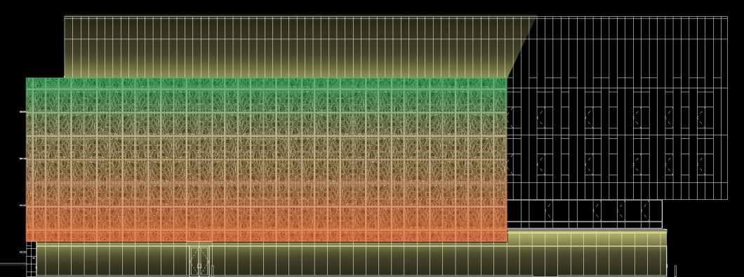
scrim/facade
building | concept | scrim | lobby | classroom | lecture hall | conclusion
Notes:
Linear color – changing floods lights mounted to top and bottom of scrim.
The vertical scrim is a single sheet of painted aluminum panel with areas of solid metal, perforated metal with a 40% openness factor (3/8” diameter holes), and voids to create the appearance of multiple layers. The panel units are 3/8” thick. The curtain wall is a butt glazed system with painted aluminum mullions and 1” insulated clear and spandrel glass, adding frit where the scrim does not screen the glazing along the second floor. Metal panels on the southern face of the building are white and gray. Natural low-e 1” clear insulated glazing units span the ground floor corridor and lobby. A laminated wood ceiling (similar to lobby/lounge) at the exterior soffit overhangs the pedestrian walkway.

Slide 25
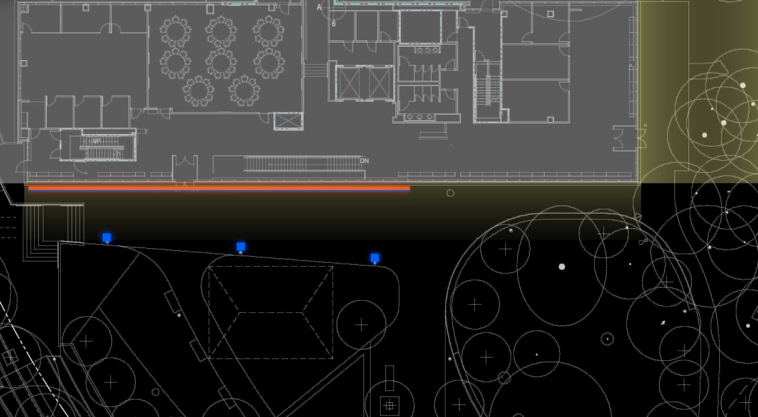
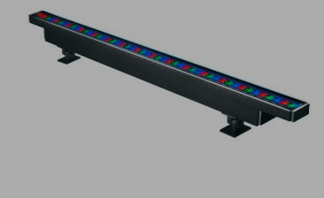
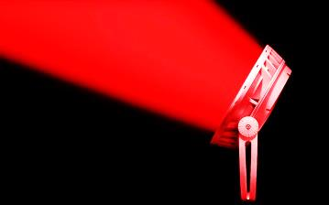
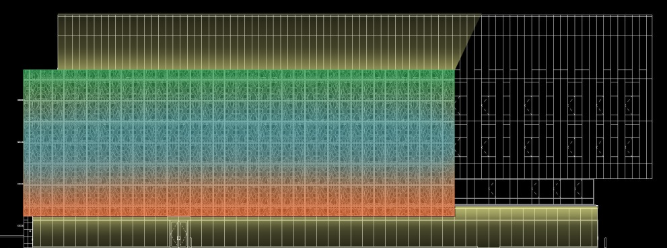
scrim/facade
building | concept | scrim | lobby | classroom | lecture hall | conclusion
Notes:
Flood spots to add another layer of light. The pattern on the side of the corridor will be subtle and interesting through the two layers of solid and perforated (40% open) aluminum panels. The shadowing will be dynamic but not distracting as it is a corridor: further studying will be done to ensure direct glare is not an issue.

Slide 26
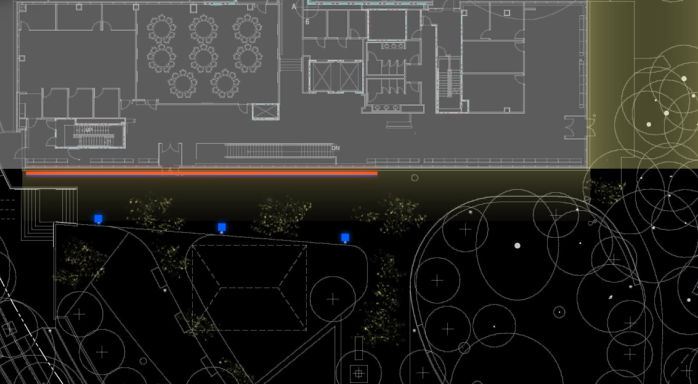
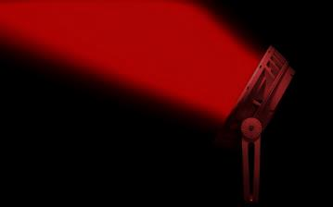
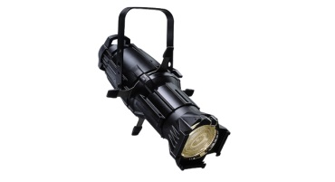
scrim/facade
building | concept | scrim | lobby | classroom | lecture hall | conclusion
Notes:
Theatrical feature to subtle create texture gobo on site much like a pile of crushed leaves encouraging passerby’s to explore. The façade as become interactive and dynamic. The glowing lobby and overhang provide way-finding and adds depth to the scrim. Illuminated corridors behind the lobby will provide another layer of depth.

Slide 27
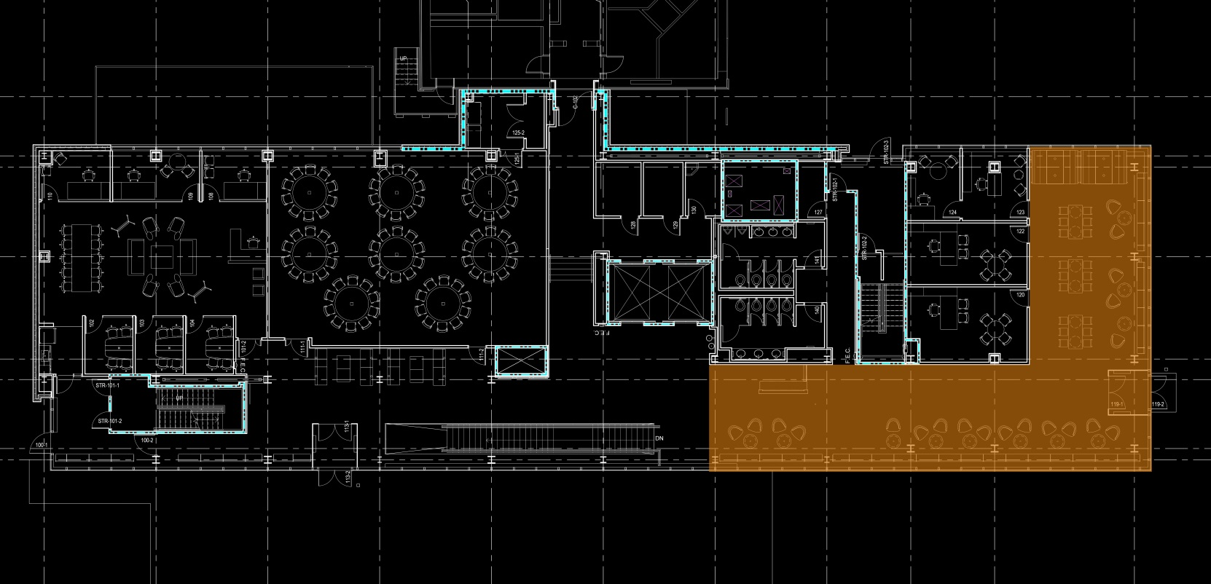
lobby
N
building | concept | scrim | lobby | classroom | lecture hall | conclusion
Notes:
1180 SF
9’6” ceiling

Slide 28
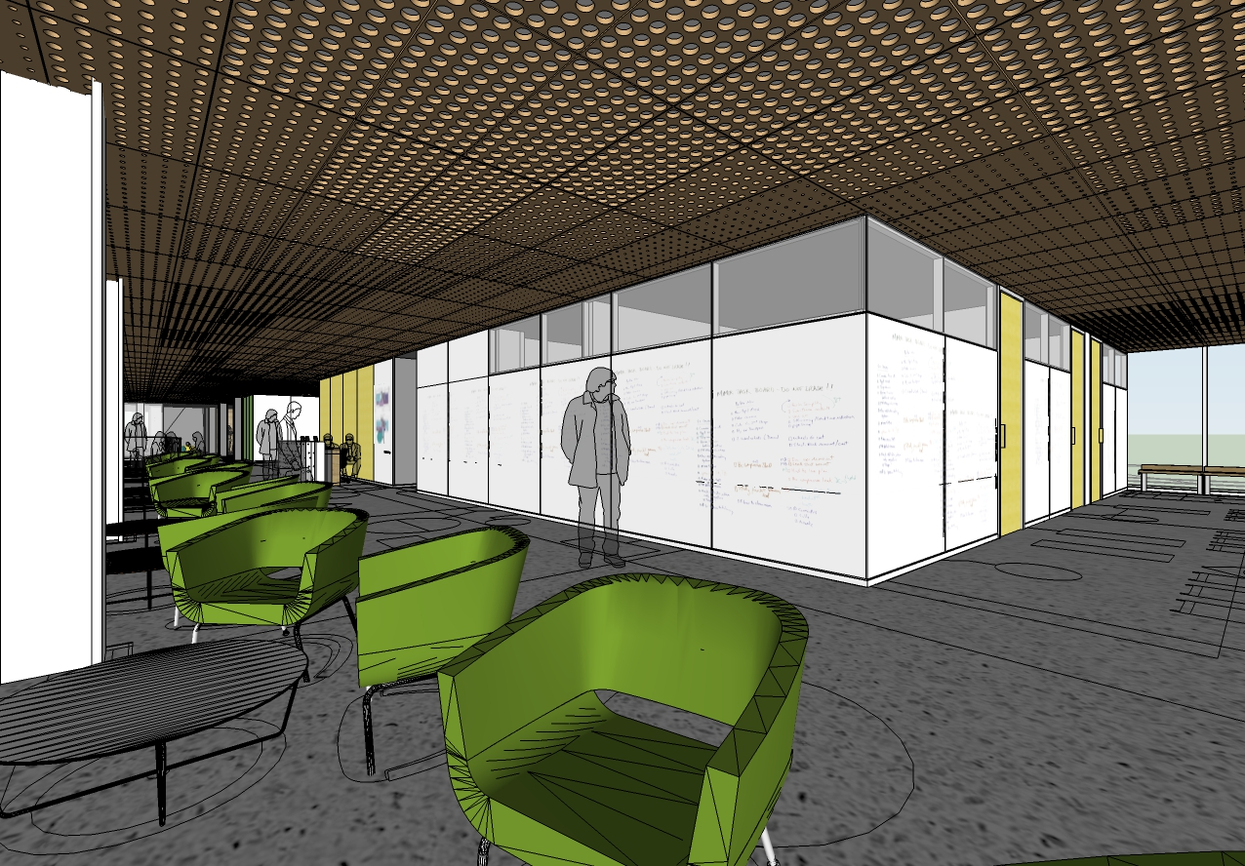
lobby
building | concept | scrim | lobby | classroom | lecture hall | conclusion
Notes:
65% clear clerestory windows above writable walls.
Exterior glazing has 65% visibility.
Lobby wall: single sided ViviChrome Scribe consists of a color interlayer (ultra white)
b/w a transparent tile of glass and an opaque glass backer.
A laminated wood ceiling at the exterior soffit overhangs the pedestrian walkway.
2.5” DIA
1.75” DIA
1” DIA
0.5” DIA
Terrazzo flooring, moveable furniture, long seat along south and east curtain walls.
Full height glazing (65% clear)

Slide 29
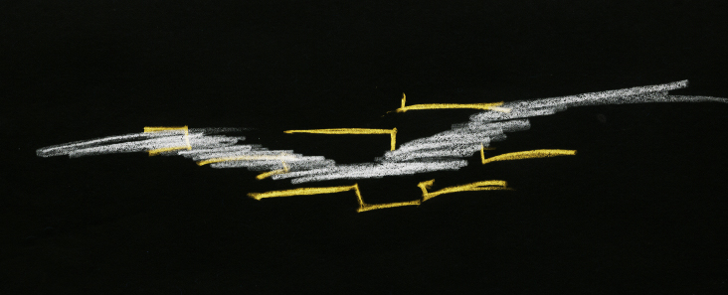
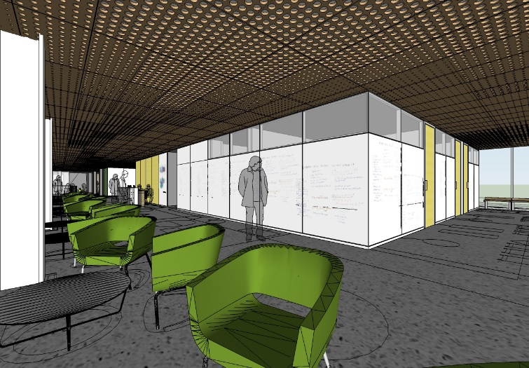
lobby
design criteria
way-finding
appearance of space
transitional lighting
daylight integration
building | concept | scrim | lobby | classroom | lecture hall | conclusion
Notes:
More high-end feeling—movement encouraged.
Use brightness to control focus and orient visitors to space.
40 lux (lounge), 150 lux (reception lobby + desk top)

Slide 30
lobby
building | concept | scrim | lobby | classroom | lecture hall | conclusion
Notes:
Through the collection of water in the roots, the sapwood in the trunk of a tree transport water and nutrients to the crown of the tree. Food (phloem) produced by leaves are sent to other parts of the tree to help to grow and expand. This is made possible by changes in pressure between the top and the bottom of the tree. Areas of congestion resemble high pressure (larger perforations and more light). A non-uniform flowing distribution of light encourages movement in the space, experience differing brightness levels of light: one can find your way in the lobby.
Perforations represent the pores (stomata) of the leaves as they evaporate water into the air. The peripheral illuminated ceiling makes the space feel light and extend past the glass perimeter allowing light to spill into the surrounding site.
“dabbled sun affect”
“intimate”
“active and movement”
“weightlessness—evaporation”
Water enters a tree through roots by osmosis and any dissolved mineral nutrients travel with it upward through the xylem (using capillary action) and into the leaves. These nutrients feed the tree through the process of leaf photosynethisis. Trees supply leaves with water because of a decrease in hydrostatic (water) pressure in upper, leaf-bearing parts called crowns or canopies. The pressure difference "lifts" the water to the leaves. Ninety percent of tree water is eventually dispersed from leaf stomata, through evaporation, into the atmosphere. That beneficial loss of water from plants is called transpiration.

Slide 31
lobby
building | concept | scrim | lobby | classroom | lecture hall | conclusion
Notes:
Bright vertical surface at guard desk to draw focus deep into space upon entry. Integrated up light flashing mullions and illuminate ceiling. Since mostly glass, the surfaces illuminated are the floor and ceiling. Glass allows one to see through to the vertical surfaces, creating a glowing box below the leaves: transfer of water, sugar, nutrients between indoor and outdoor space. It is a public space of transition and fluidity.
RELAXED (non-uniform horizontal illumination) AND PLEASANT (vertical illumination) AND SPACIOUSNESS (ceiling illumination)

Slide 32
lobby
building | concept | scrim | lobby | classroom | lecture hall | conclusion
Notes:
Downlights integrated into ceiling perforations: subtle pools of light.

Slide 33
lobby
building | concept | scrim | lobby | classroom | lecture hall | conclusion
Notes:
Wall washing

Slide 34
lobby
building | concept | scrim | lobby | classroom | lecture hall | conclusion
Notes:
Grazing wood feature wall.

Slide 35
lobby
building | concept | scrim | lobby | classroom | lecture hall | conclusion
Notes:
Perimeter uplight.

Slide 36
lobby
building | concept | scrim | lobby | classroom | lecture hall | conclusion
Notes:
Grazing cantilever wood ceiling with integrated downlights to further extend the lobby to the outside.

Slide 37
classroom
N
building | concept | scrim | lobby | classroom | lecture hall | conclusion
Notes:
Collaborative space with windows to northwest of room.
Occupancy sensors and controls for use with southern white board and projection screens (east & west walls)
1700 SF
50’x35’
9’6” acoustic ceiling tile, white walls, darker 3-color variation carpet

Slide 38
classroom
design criteria
productive task lighting
reduce direct glare
scene controls
building | concept | scrim | lobby | classroom | lecture hall | conclusion
Notes:
200 – 500 lux (reading writing)
50 lux (AV presentation)

Slide 39
classroom
building | concept | scrim | lobby | classroom | lecture hall | conclusion
Notes:
Functionally, trees have branches so that leaves can reach as much light as possible. This is for the tree to productively produce nutrients.
Much like standing underneath a tree, branches may be asymmetric but sunlight filters through the leaves in a glowing manner. Indirect/direct system provides uniform light on the task surface while minimizing glare. Branching areas can be separately controlled to allow for better lighting controls in space.
PUBLIC AND SPACIOUS

Slide 40
lecture hall
N
building | concept | scrim | lobby | classroom | lecture hall | conclusion
Notes:
3200 SF
Width: 90’
Height: 55’
Ceiling height: 13’
(11’-15’)

Slide 41
lecture hall
building | concept | scrim | lobby | classroom | lecture hall | conclusion
Notes:
Custom white fiberglass ceiling and wall system
Yellow wood veneer on back wall

Slide 42
lecture hall
design criteria
uniform task lighting
appearance of space
scene control
reduce direct glare
public impression
building | concept | scrim | lobby | classroom | lecture hall | conclusion
Notes:
Reading writing: 200 lux horizontal
50 lux for AV
2:1 horz. avg/min illuminance ratio
200 lux on speakers face
400 lux on front wall for whiteboard use

Slide 43
lecture hall
schematic I
building | concept | scrim | lobby | classroom | lecture hall | conclusion
Notes:
Molecular structure, or the brains of the tree.
Both in phloem (inner bark)
Large = sieve tubes to transport photosynthates down the stem
Small = companion cells provide sieve tube elements with needed metabolites

Slide 44
lecture hall
building | concept | scrim | lobby | classroom | lecture hall | conclusion
Notes:
The fiberglass ceiling are the larger cells, smaller sources of light are packed between the cells through which nutrients are carried. The impression is enclosing but uniform. The focus is on the verticality of the space or the motion upwards.
Lighting is somewhat private and wraps the occupant into the space. Brighter areas are the podium, front white board, and tables.
PUBLIC (direct overhead system) AND VISUALLY CLEAR (uniform task lighting) AND RELAXED (walls)

Slide 45
lecture hall
building | concept | scrim | lobby | classroom | lecture hall | conclusion

Slide 46
lecture hall
building | concept | scrim | lobby | classroom | lecture hall | conclusion
Notes:
Vertical recessed linear mounted to yellow wood veneer wall.

Slide 47
lecture hall
building | concept | scrim | lobby | classroom | lecture hall | conclusion
Notes:
Light leaking from the side cells, grazing the curved forms and drawings the viewer’s focus forward to the presenter.

Slide 48
lecture hall
building | concept | scrim | lobby | classroom | lecture hall | conclusion
Notes:
Functional wall-washing

Slide 49
lecture hall
building | concept | scrim | lobby | classroom | lecture hall | conclusion
Notes:
Track lighting for use with AV scene

Slide 50
lecture hall
building | concept | scrim | lobby | classroom | lecture hall | conclusion
Notes:
Custom formed fiberglass panels
Uniform light distribution through direct point sources. The curves of the fiberglass ceiling will be revealed in shadow and indirect light.

Slide 51
lecture hall
schematic II
building | concept | scrim | lobby | classroom | lecture hall | conclusion

Slide 52
lecture hall
building | concept | scrim | lobby | classroom | lecture hall | conclusion
Notes:
The canopy of a group of trees allow some light to fall onto the ground below. A tree seems light and floating, almost too high to reach.
Still providing functional lighting, the custom ceiling would be constructed from a more transparent material, like a stretched fabric. By creating a glowing ceiling, the space is expanded. Perimeter lighting aids to make the ceiling feel light and as if there is something above the underground space. Comfortable and public.
SPACIOUS (perimeter lighting and glowing ceiling) AND PLEASANT(periphery highlighted)

Slide 53
lecture hall
building | concept | scrim | lobby | classroom | lecture hall | conclusion
Notes:
Same functional lighting

Slide 54
lecture hall
building | concept | scrim | lobby | classroom | lecture hall | conclusion
Notes:
Perimeter grazing—interesting forms on walls.

Slide 55
lecture hall
building | concept | scrim | lobby | classroom | lecture hall | conclusion
Notes:
More transparent, backlighting. A system would need to be constructed (probably with white paint) so that light could effectively reflected back into the space. Light can be achieved with a simple fluorescent system.

Slide 56
lecture hall
schematic III
building | concept | scrim | lobby | classroom | lecture hall | conclusion

Slide 57
lecture hall
building | concept | scrim | lobby | classroom | lecture hall | conclusion
Notes:
Trees behind growth through germinated seeding: a taproot grows straight down from which lateral roots later branch out radially from this point. The roots collected water to send water to the leaves above (scrim).
KEEPING ESSENCE OF CEILING: floating, organic just for effective way of lighting. Lighting is public, indirect, and comfortable. Focus is towards the front through layered curving planes of light.
SPACIOUS (indirect system and perimeter lighting) AND PUBLIC (overhead uniform system) + LIGHTING PATTERN COMPLEMENTS FORM

Slide 58
lecture hall
building | concept | scrim | lobby | classroom | lecture hall | conclusion
Notes:
Same functional lighting

Slide 59
lecture hall
building | concept | scrim | lobby | classroom | lecture hall | conclusion
Notes:
Layered planes of light using cove lighting or grazing to indirectly light the space.

Slide 60
connections through biomimicry
building | concept | scrim | lobby | classroom | lecture hall | conclusion
Notes:
If we were to revisit this original sketch and now treat the outer context layer as the brain (as shaped)…

Slide 61
connections through biomimicry
building | concept | scrim | lobby | classroom | lecture hall | conclusion
Notes:
…then the interaction area, much like on an MRI (magnetic resonance imaging) or PET (positron emission tomography) scan, is the most active area of the brain. The NBS building will become the central place for Natural Science students to come to and interact; the lighting responds to the students and Richard Shultz initial statements.

Slide 62
connections through biomimicry
building | concept | scrim | lobby | classroom | lecture hall | conclusion
Notes:
By establishing a spherical interaction between the building, nature, and most importantly, the students, the lighting speaks to the interests of the Natural Science students and reinforces that the new NBS building is the central place for community connection and activity.
Biomimicry of a deciduous tree inspires the lighting solution to conceptually connect the architecture and students of the program.

Slide 63
thank you
Shawn Good
Dr. Mistrick
Dr. Houser
Penn State AE Department
SmithGroupJJR
Lutron

Slide 64
references
http://farm8.staticflickr.com/7053/6860659863_a9ce796709_o.jpg
http://www.corbisimages.com/images/Corbis-42-21818497.jpg?size=67&uid=115a2d8e-50cd-4d27-a282-dbd2ca2dea47
http://www.wallpaperup.com/uploads/wallpapers/2013/01/01/27252/7aed01fc2712feed95a6c622351f6d67.jpg
http://starwall.info/orange-autumn-tree-leaves-art-prints-baslee-troutman.html
http://www.wallsfeed.com/tree-trunk-roots/
http://www.borealgardening.com/resources/maple_tree_bud.jpg
http://farm1.static.flickr.com/44/155429994_563c44e895.jpg
http://www.chemlabs.bris.ac.uk/cetlpics/Outreach/Chemnet_NAGTY06labbig.jpg
ASHRAE 90.1 – 2010
IES Handbook
LEED

Slide 65
support | scrim
The vertical scrim is a single sheet of painted aluminum panel with areas of solid metal, perforated metal with a 40% openness factor (3/8” diameter holes), and voids to create the appearance of multiple layers. The panel units are 3/8” thick. The curtain wall is a butt glazed system with painted aluminum mullions and 1” insulated clear and spandrel glass, adding frit where the scrim does not screen the glazing along the second floor. Metal panels on the southern face of the building are white and gray. Natural low-e 1” clear insulated glazing units span the ground floor corridor and lobby.

Slide 66
support | scrim

Slide 67
support | lobby
Lobby wall: single sided ViviChrome Scribe consists of a color interlayer (ultra white)
b/w a transparent tile of glass and an opaque glass backer.

Slide 68
support | lobby

Slide 69
support | lecture hall

Slide 70
support | lecture hall

